Slide 1
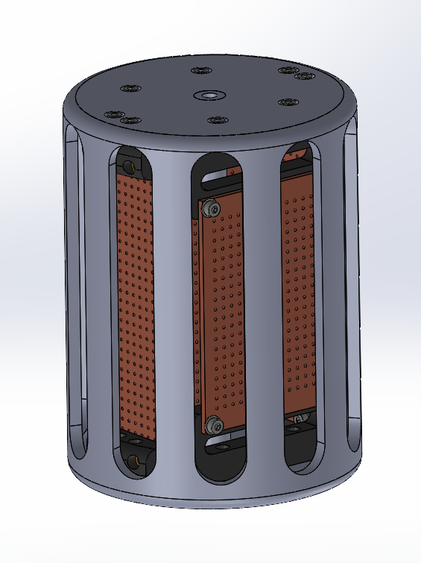
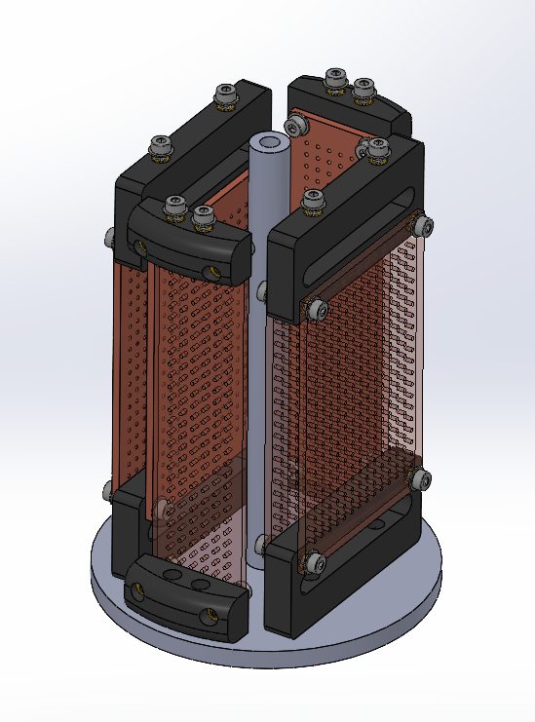
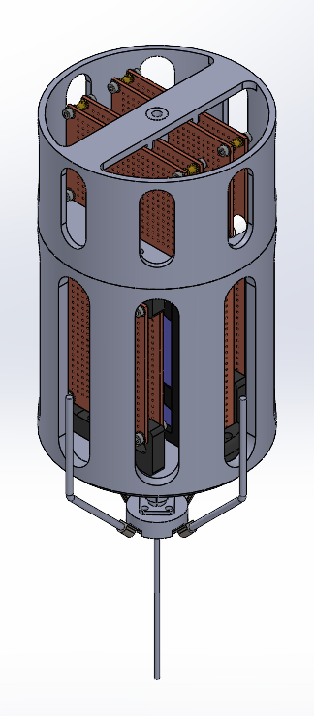
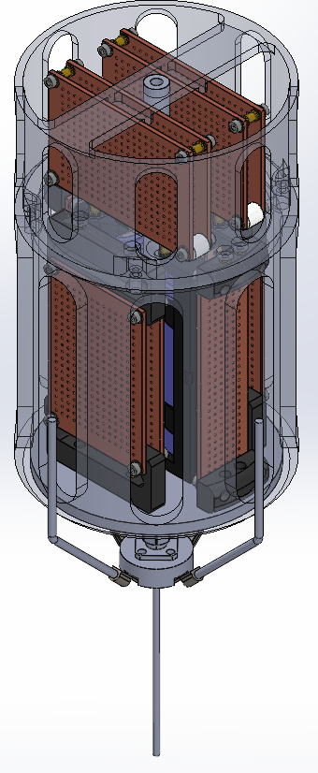
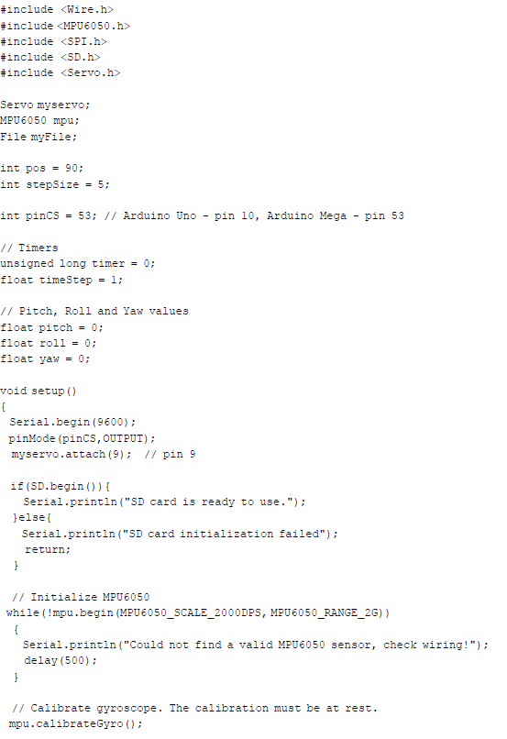
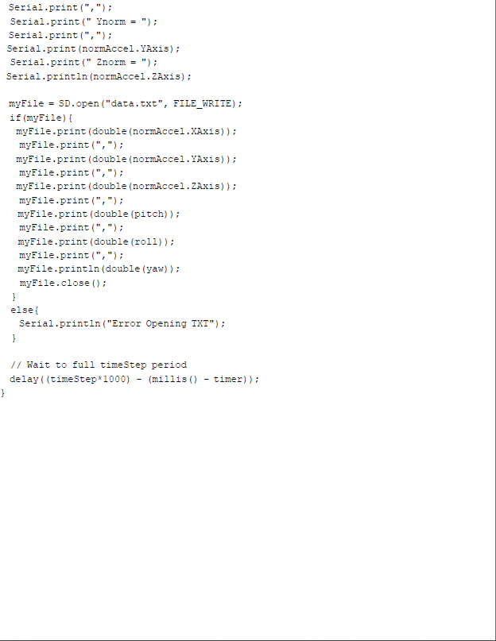
Development of Autonomously Guided High Altitude Payload System
Aleksander Angel Aleman, Noah Hejazi, Francisco Briceno, Peter Gonzalez, Daniel Heyninck
Department of Mechanical and Materials Engineering, Florida International University, Miami, FL, USA
Introduction
Results
Joint Precision Airdrop System
JPADS commonly refers to the "Joint Precision Airdrop System." JPADS is a military technology that involves precision airdrop systems used by the United States and other allied forces for delivering supplies, equipment, and humanitarian aid from aircraft to specific locations on the ground. JPADS is designed to provide accurate and controlled cargo delivery to a designated drop zone. It aims to reduce the dispersion of supplies and improve the accuracy of airdrops. JPADS relies on GPS technology to guide the airdropped cargo to its intended destination. GPS allows for precise navigation and targeting during the airdrop.
Algae Bloom Surveillance
Algae bloom surveillance is especially important in regions where blooms can have harmful effects on water quality, aquatic life, and human health. Monitoring efforts are often collaborative, involving government agencies, research institutions, environmental organizations, and the public. The goal is to better understand and manage algae blooms to protect both ecosystems and human communities. Satellite imagery and remote sensing technologies play a crucial role in monitoring large water bodies. Remote sensing allows for the detection of changes in water color and the identification of potential algae blooms from space.
Crop surveillance
Crop surveillance involves the systematic monitoring and assessment of agricultural fields and crops using various technologies and methodologies. The goal of crop surveillance is to gather information that can be used to make informed decisions related to crop management, yield prediction, disease detection, and overall agricultural productivity. Remote sensing satellites capture high-resolution images of agricultural landscapes. These images can be analyzed to assess crop health, growth patterns, and detect anomalies. Aerial Surveys: Unmanned aerial vehicles (UAVs or drones) equipped with cameras or sensors are used for detailed and localized monitoring of crops. Drones can provide higher resolution imagery compared to satellites.
Deployment of Solar Cells in Space Systems
The deployment of solar cells in space systems involves the integration of solar power generation technology into satellites, spacecraft, and other space vehicles. Solar cells, also known as solar photovoltaic (PV) cells, convert sunlight into electricity, providing a reliable and sustainable power source for various space missions.
Design
4.1
4.5
4.2
Coding
4.4
Main Objective: Development of a modular weather balloon system designed to autonomously maneuver and landed research payloads.
Upgrades for 5.1
Applications
Upgrades to chassis & JPADS
LiDAR
Custom PCBs
Algae Bloom and Crop Surveillance
Space Systems Solar Cells Deployment Testing
Acknowledgements
EML 4806 Modeling and Control of Robots
Instructor: Dr. A. HAMRANI

